Slide 1
Brighton Snow Safety Avalanche Mitigation Mornings, an Operational Timeline
By – Peter Tucker

Slide 2
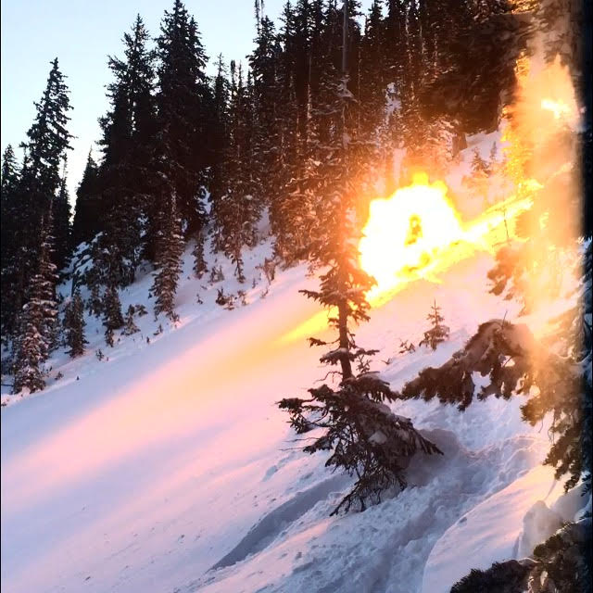
All storms/seasons are different, and as such we have a dynamic approach, the following is a traditional “all hands-on deck” approach for a full avalanche mitigation morning. Knowing we may, or do, have mitigation work the following morning, resort personnel (cat crew, lift maintenance, mountain operations) are informed the day before. Additionally on-going planning, discussion, and strategy is taking place between myself, Max, Todd, Jr., and other resort personnel.
Make up room after assembling shots
Air Blast detonating in Snake Bowl

Slide 3
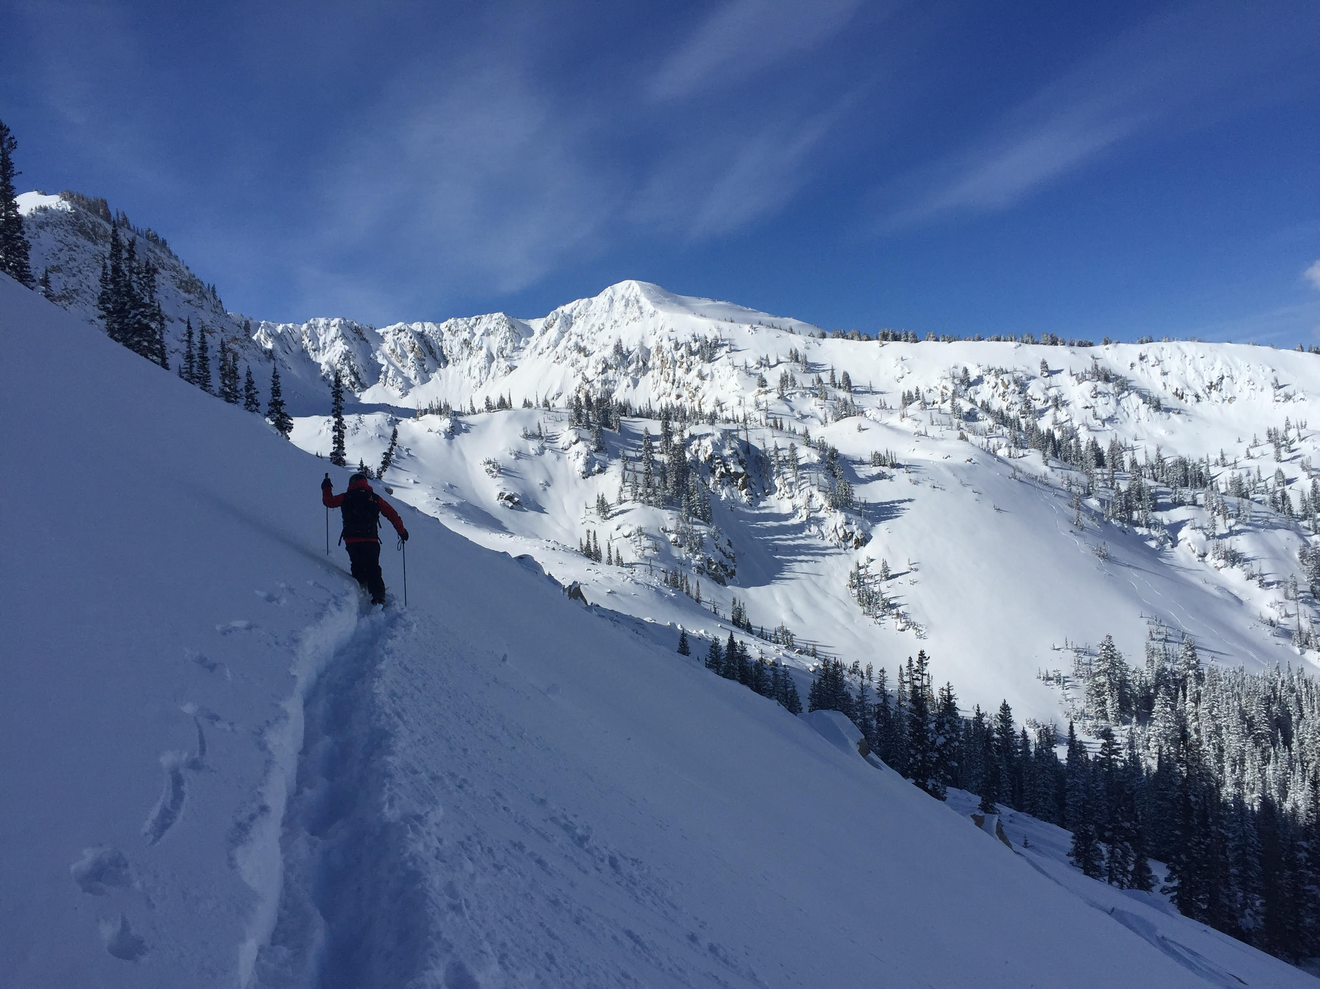
The following is the traditional approach to mitigation mornings. This season, anticipate some changes, so we can try and stay as safe as possible. Flexibility in this regard, will be greatly appreciated.
Chris Stowe assessing Backdoor

Slide 4
3 AM wake up, get text from cat crew with their observations from the night - wind, snowfall rates, etc., 12-hour, 24-hour, and snow stake totals from mid mountain study plot, ex. 11”, 19”, 27”.
03:00 - Make coffee and head up canyon; making observations en route – wind, snow (PI) rates, slides along road, snow depth/feel on road, etc.
04:00 – Get to resort, switch traffic light (uphill policy indicator) to RED if it’s not already.
04:00-04:45 – Weather observations, for UAC and Brighton; snow totals (12, 24, storm total) and H2O weights, winds, avalanche activity, etc…
04:45-05:00 – Call patrollers in (ANSWER YOUR PHONE), check in with cat crew for cache run.
05:00-05:30 – Continue checking forecasts, discussions, today’s Wx forecast, and anticipated avalanche problems for the day. Finalize control teams and shot numbers.

Slide 5
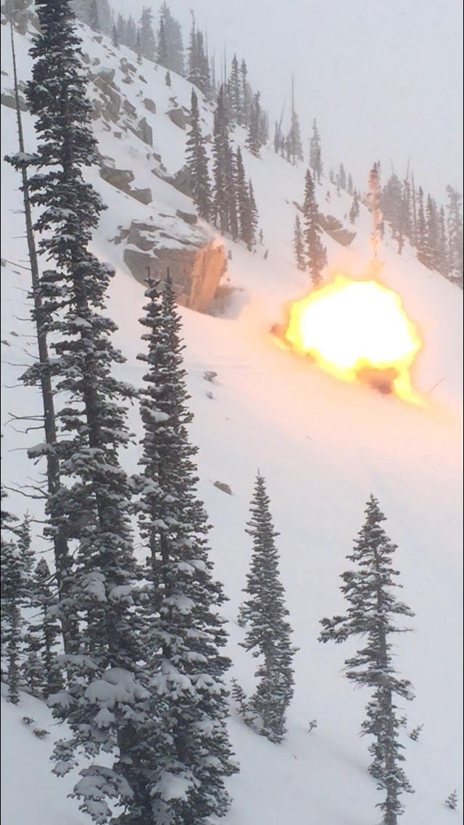
05:30 – Cat ride to cache, pull explosives
06:00-06:30 – Build shots
06:00-06:30 – Patrollers arrive, allow plenty of time for poor canyon driving conditions, and plows. It’s better to be late, then not make it. Advise snow safety personnel via text or call if late.
6:30 AM – Morning meeting with boots on, discuss the weather and storm, weather for the day, along with anticipated avalanche problems for the day.
06:30-07:00 – Review mitigation teams and shot numbers. Discuss plan with your team. Checklist- shots, ignitors/spitters, crimpers, tape, radio, skins, beacon/shovel/probe, boo? mittens? coffee? snack?
06:50 – Fire Gazex and announce via radio, Tuck, Max, other
07:00 – Cat rides to Snake and Western top, from Alpine Rose. Remember straps for cat!
07:00-07:15 – Crest and Milly spinning for mitigation teams
07:15 – 08:15ish – Mitigation teams out doing work. Radio call when you start, make sure all personnel is clear. Useful radio obs, clear comms, stay focused on getting your zone cleared.
Air Blast going off in Backdoor

Slide 6
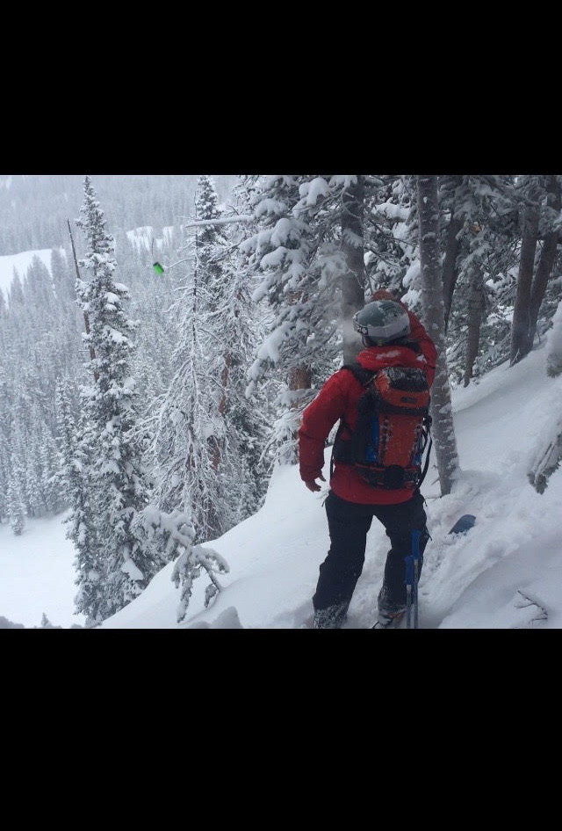
08:15-08:30ish – Teams wrapping up, giving a ‘Down and Clear’ with results. One Pioneer team to playground and snow stake, one Pioneer team to Milly to help clean up (check with Milly team regarding more shots?)
08:30ish – Drop off unused shots in make up room, go to assigned lift, unless told to go else where.
08:30 – 09:00 – GET THE HILL OPEN!
It is our job to get the hill open, before free skiing.
09:00 - 16:00 – Continuous monitoring of avalanche terrain and weather, mitigated via ski cutting and closing terrain, as necessary.
Avalanche mitigation work is a part of being a pro patroller. It is usually a difficult working environment (cold, snowy, windy, poor visibility, etc.). It is our job to manage stressful working environments with preparedness, mental toughness, teamwork, clear communication, and an ability to make, alter, and detach from plans as we see fit. There is no ‘correct’ way to do mitigation work, but there are a lot of wrong ways.
17:00 – Have shot sheet done before going home, it’s the responsibility of the route leader that it gets done.
17:00 – PM Weather Observations, rinse and repeat?
Abby Gahm putting some English on it, above P-Texs

Slide 7
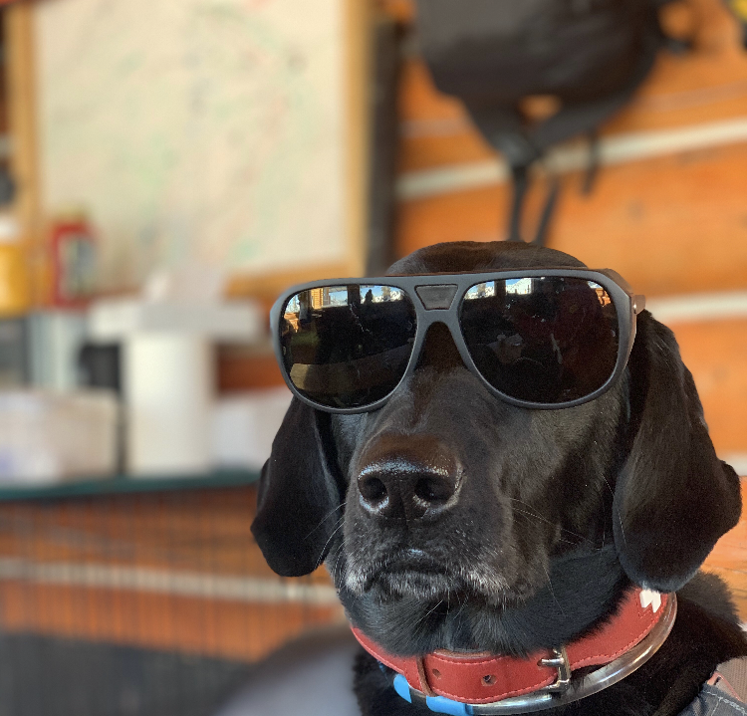
Weekend Avalanche Mitigation
The morning looks the exact same as a weekday. Feel free to take a little more time on route, as we have the weekend crew of volunteer patrollers heading out to get the hill open.
When you finish your route, check in with patrol on the lift you’ve been doing mitigation work on, and see how you can help. And/or check with Milly patrol on route, to see if they could use more help with clean up.
Ski the lift you’ve done mitigation work on; if Snake and/or Western aren’t spinning, go to Crest.
Do not go to Milly and crush the bowl!!!
Clock out by 10:00
GET SHOT SHEET/MITIGATION LOG DONE BEFORE GOING HOME, IT’S THE RESPONSIBILITY OF THE ROUTE LEADER THAT IT GETS DONE!

